Slide 1

Introduction to JavaScript
Day 1: Basics, Syntax, and Simple Examples

Slide 2
What is JavaScript?
High-Level & Interpreted
Makes Web Pages Interactive
Runs Everywhere
Easy to read and understand
Adds dynamic behavior
Browser (Frontend)
Executed line by line
Brings pages to life
Servers (Backend - Node.js)
Examples: Form validation, animations, dynamic content updates.

Slide 3




Why Learn JavaScript?
Web Development
Mobile Apps
Games & IoT
Build with React Native
Simple game logic
Frontend (React, Angular, Vue)
Raspberry Pi projects
Backend (Node.js)

Slide 4
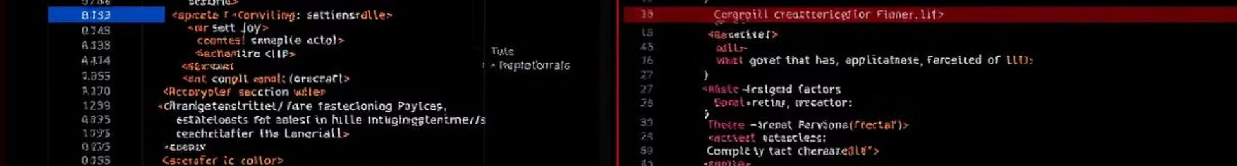



Setting Up JavaScript
Browser Console
Quick testing with F12 (Console)
HTML File
<script> console.log("Hello, JavaScript!"); </script>
External JS File
<script src="script.js"></script>

Slide 5

Variables & Data Types
Variables
Data Types
Example
let (reassignable)
Number (e.g., 25)
const (constant)
String (e.g., "Alice")
let price = 99.99;
Avoid var (modern JS)
Boolean (true/false)
null & undefined
const taxRate = 0.08;
let product = "Laptop";

Slide 6
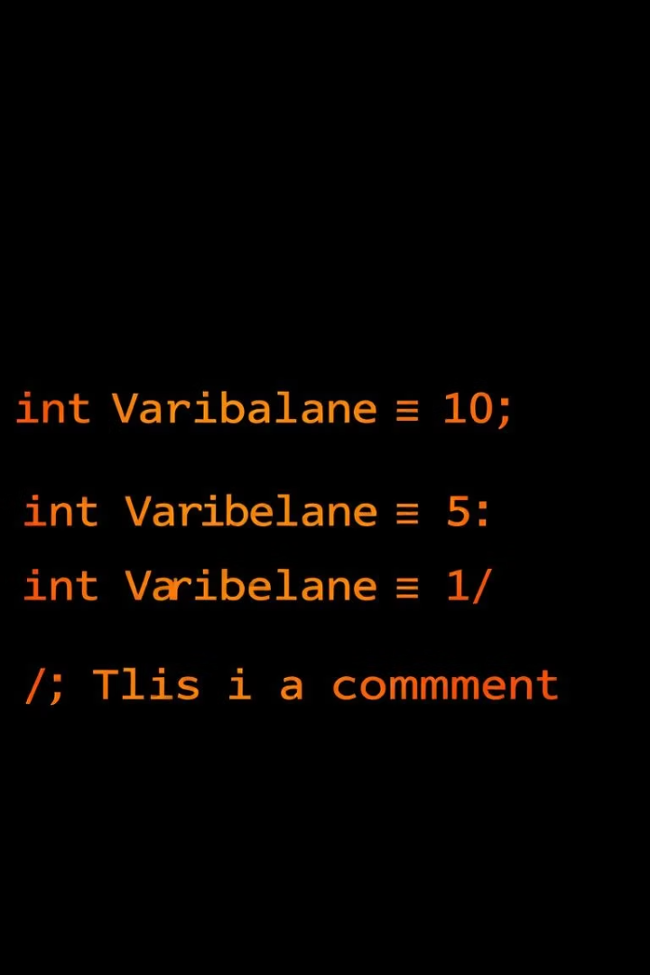
Basic Syntax & Rules
Case-Sensitive
Statements End with ;
myVar ≠ myvar
Optional but recommended
Comments
// Single-line
/* Multi-line */

Slide 7



Operators
Comparison
2
==, ===, !=, >, <
e.g., isEqual = (10 === "10");
Arithmetic
+, -, *, /, %
1
e.g., total = 10 + 5;
Logical
&&, ||, !
3
e.g., canDrive = (age >= 18 && hasLicense);

Slide 8
Real-World Example: Simple Calculator
10
5
15
First Number
Second Number
Sum Result
num1 variable
num2 variable
Calculated sum
let num1 = 10;
let num2 = 5;
let sum = num1 + num2;
console.log("Sum:", sum); // Sum: 15

Slide 9

Conditional Statements (if-else)
You can vote!
If age is 18 or more
Too young to vote.
Else, age is less than 18
let age = 20;
if (age >= 18) {
console.log("You can vote!");
} else {
console.log("Too young to vote.");
}
Real-World Example:
let temperature = 25;
if (temperature > 30) {
console.log("It's hot outside!");
} else {
console.log("Weather is pleasant.");
}

Slide 10


Loops (for, while)
While Loop
Condition-based
For Loop
Known iterations
let count = 0;
for (let i = 1; i <= 5; i++) {
while (count < 3) {
console.log("Count:", i);
console.log("Loading...", count);
}
count++;
}
Real-World Example: Multiplication table of 2
for (let i = 1; i <= 10; i++) {
console.log(`2 x ${i} = ${2 * i}`);
}

